Slide 1


Slide 2


Ford & General Motors
Sustainability & Risk
Jeffery Morse
Social Responsibility and Risk
Brandman University

Slide 3
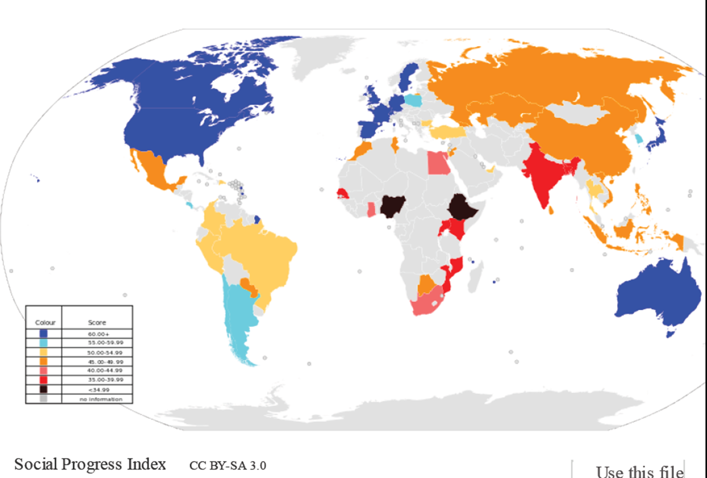
Notes:
Here is the bottom line of Sustainability
The world’s population continues to grow, and the non renewable resources that once were the foundation of industry can no longer support the advancing populations.
Outcry for human rights, safety, and fair wage is promoting business to find innovative ways to care for people and still make a profit.
Climate change, ocean die-off and soil / water contamination and reclamation have produced a necessity for care of the planet.

Slide 4
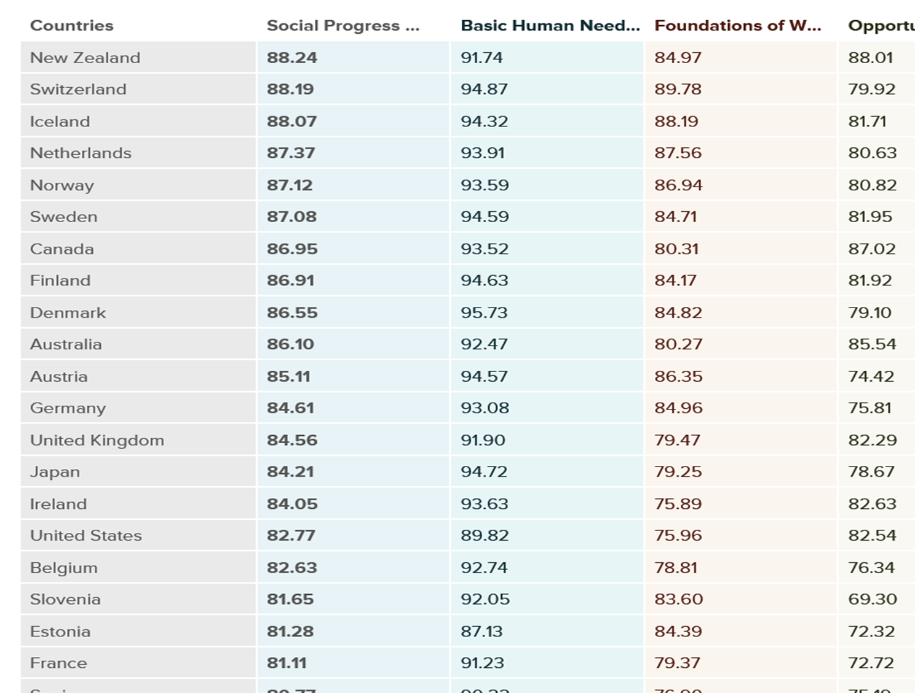
Social Progress Continues To Increase
Notes:
Third world countries are advancing.

Slide 5
Sustainability
Maintaining a state of a dynamic balance of a system with its major elements interacting with each others and its relations with the higher system.

Slide 6
Sustainability
In The
Supply Chain
Re-use
Re-manufacturing
Re-conditioning
Recycling
Re-store
Re-claim

Slide 7
Supply Chain
Sustainability
(SCS)
Means
SCS means green purchasing, mfg., distribution, reverse supply chains and logistics.
Integrating the three Ps (people, planet and profit).
Considers the entire life cycle of a product. Including product design, material sourcing, mfg., delivery, operations, and disposal point of views.
SCS means to do no harm to the environmental or social systems, while still making profit in the long run.
Sustainable market framework:
Cradle to Cradle
Reverse Supply Chain & Closed Loop
Green Innovative options that work in harmony

Slide 8

GM was founded in 1908 and today sells its vehicles in around 200 countries with manufacturing operations in more than 30 countries. General Motors (NYSE: GM), once the world's largest vehicle manufacturer, is currently 13 on Fortune 500. GM’s supply chain extents over 20,000 businesses are spending $100 billion on about 200,000 items, including raw materials, parts, supplies, freight, transportation, and other services an employs about 173,000 people globally, less than any amount since 2010. GM also operates one of the largest and most successful financial services companies, GMAC.
GM is widely diversified from auto to a large assortment of other types of engines. After purchasing Winton Motor Carriage Company in 1930 GM marketed extended engine groups which included diesel, locomotive, and aircraft engines in the US. GM also has the industry-leading in-vehicle communications and information service, DirecTV, all types of appliances, Cell technologies and others. GM’s new Personal Calling service provides hands-free, voice-activated, in-vehicle cellular phone access.
On the down side GM’ was by far the largest bailout in 2008. The bankruptcy was mainly due to the banking fiasco but many feel that miss management also played a big part. As a result, CEO Rick Wagoner was forced to resign.
GM's bankruptcy was one of the biggest Chapter 11 filings in U.S. history. This bankruptcy was he fourth-largest in U.S. history, following 1. Lehman Brothers Holdings Inc., 2. Washington Mutual and 3. WorldCom Inc
GM is looking to the future when it comes to sustainability with a goal of having 90% of their vehicles electric zero emission vehicles by year 2030.
Notes:
GM was founded in 1908 and today sells its vehicles in around 200 countries with manufacturing operations in more than 30 countries. General Motors (NYSE: GM), once the world's largest vehicle manufacturer, is currently twelfth on Fortune 500. GM’s supply chain extents over 20,000 businesses are spending $100 billion on about 200,000 items, including raw materials, parts, supplies, freight, transportation, and other services an employs about 173,000 people globally, less than any amount since 2010. GM also operates one of the largest and most successful financial services companies, GMAC.
GM is widely diversified from auto to a large assortment of other types of engines. After purchasing Winton Motor Carriage Company in 1930 GM marketed extended engine groups which included diesel, locomotive, and aircraft engines in the US. GM also has the industry-leading in-vehicle communications and information service, DirecTV, all types of appliances, Cell technologies and others. GM’s new Personal Calling service provides hands-free, voice-activated, in-vehicle cellular phone access.
On the down side GM’ was by far the largest bailout in 2008. The bankruptcy was mainly due to the banking fiasco but many feel that miss management also played a big part. As a result, CEO Rick Wagoner was forced to resign.
GM's bankruptcy was one of the biggest Chapter 11 filings in U.S. history. This bankruptcy was he fourth-largest in U.S. history, following 1. Lehman Brothers Holdings Inc., 2. Washington Mutual and 3. WorldCom Inc.
GM is looking to the future when it comes to sustainability with a goal of having 90% of their vehicles electric zero emission vehicles by year 2030.

Slide 9
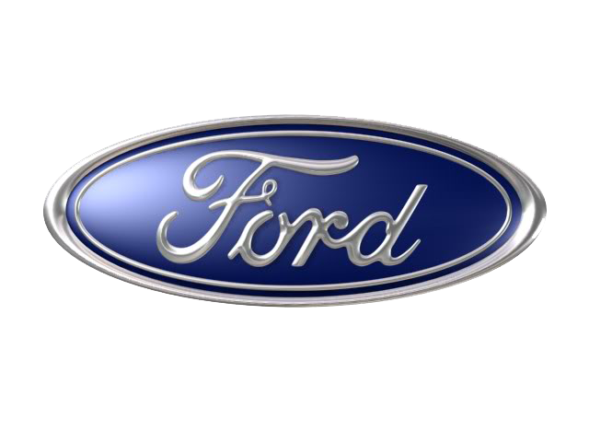
Ford Motor Company began in, 1903, when Henry Ford & associates filed incorporation in Michigan. After that Ford became the world's largest corporations.
The Ford Motor Company is represented in more than 200 nations and territories on six continents. Today, Ford Motor Company is the world's largest producer of pickups being the farm favorite. Today Ford employs more than 190,000 people which is about half of its peak in 1997.
In 1976, Ford Motor Company decided to go global with the first successful front wheel drive “the Fiesta”. Ford Motor Company is ranked 11 on Fortune 500 list.
Ford is also very diversified and it is best known for cars and trucks but also is involved in industrial engines, glass, plastics, financial services, replacement parts, and electronics. Ford Motor Company’s leadership believes that diversity will be the engine that powers the future.
Ford did not really need to be bailed out in 2008 as GM did. They did however take a much smaller loan of six billion in fear that the 36 billion dollar bailout of GM would leave them in the dust.
Fords sustainability approach is all about people. They believe championing human rights and diversity is the answer. However, they are still perusing alternative energy and though electric zero emission vehicles are part their main efforts are in Hybrid Gas Technologies.
Notes:
Ford Motor Company began in, 1903, when Henry Ford & associates filed incorporation in Michigan. After that Ford became the world's largest corporations.
The Ford Motor Company is represented in more than 200 nations and territories on six continents. Today, Ford Motor Company is the world's largest producer of pickups being the farm favorite. Today Ford employs more than 190,000 people which is about half of its peak in 1997.
In 1976, Ford Motor Company decided to go global with the first successful front wheel drive “the Fiesta”. Ford Motor Company is ranked 11 on Fortune 500 list.
Ford is also very diversified and it is best known for cars and trucks but also is involved in industrial engines, glass, plastics, financial services, replacement parts, and electronics. Ford Motor Company’s leadership believes that diversity will be the engine that powers the future.
Ford did not really need to be bailed out in 2008 as GM did. They did however take a much smaller loan of six billion in fear that the 36 billion dollar bailout of GM would leave them in the dust.
Fords sustainability approach is all about people. They believe championing human rights and diversity is the answer. However, they are still perusing alternative energy and though electric zero emission vehicles are part their main efforts are in Hybrid Gas Technologies.

Slide 10
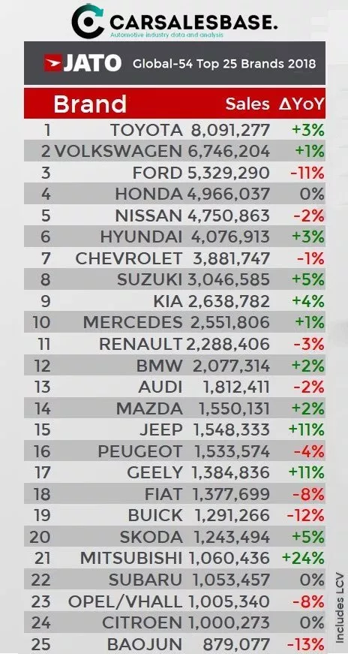
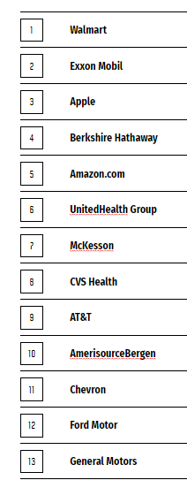
Today Ford and GM still run pretty close in everything. To the left is the global sales report by Jato. Ford is listed at #3 among auto brands selling five million plus vehicles and GM (listed as Chevrolet) has almost four million. On the right is the 2019 fortune 500 list with Ford at 12 and GM at 13.
Notes:
Today Ford and GM still run pretty close is everything. To the left is the global sales report by Jato. Ford is listed at #3 among auto brands selling five million plus vehicles and GM (listed as Chevrolet) almost four million. On the right is the 2019 fortune 500 list with Ford at 12 and GM at 13.

Slide 11

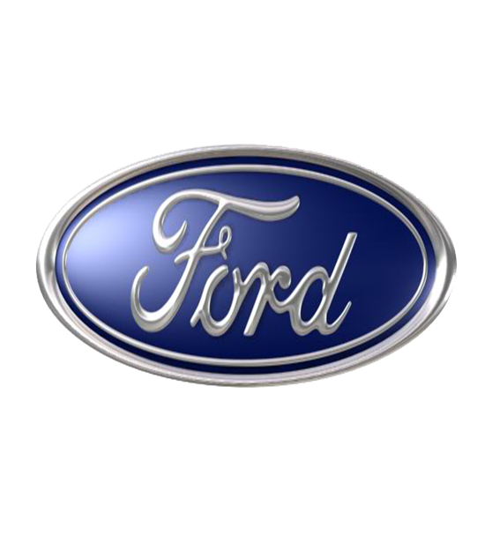

CORPORATE SUSTAINABILITY AND SOCIALLY RESPONSIBLE INITIATIVES
General Motors was ranked on the Dow Jones Sustainability Index (DJSI) for corporate sustainability leadership. For the second year GM was listed as an index component. GM is the only automaker on the North American index!
The DJSI is the leading global benchmark for corporate sustainability. Tracking leading sustainability-driven companies based on investment of financially relevant environmental, social and governance factors.
Not very creative, but this is innovative as they are the only one.
In Jan. 2019 – Ford receive an A grade for its water security efforts from the CDP global disclosure system. CDP drives sustainable economies my monitoring environmental impact. This is the fourth year Ford has earned an A from CDP for water management.
Ford is one of fewer than 30 companies globally get this award.
On the flip side GM tends to try to side step water reclamation through petitions when possible.
This is not very creative but is innovative as all firms need to do this.
Notes:
General Motors was ranked on the Dow Jones Sustainability Index (DJSI) for corporate sustainability leadership. For the second year GM was listed as an index component. GM is the only automaker on the North American index!
The DJSI is the leading global benchmark for corporate sustainability. Tracking leading sustainability-driven companies based on investment of financially relevant environmental, social and governance factors. Not very creative, but this is innovative as they are the only one.
In Jan. 2019 – Ford receive an A grade for its water security efforts from the CDP global disclosure system. CDP drives sustainable economies my monitoring environmental impact. This is the fourth year Ford has earned an A from CDP for water management.
Ford is one of fewer than 30 companies globally get this award.
On the flip side GM tends to try to side step water reclamation through petitions when possible. This is not very creative but is innovative as all firms need to do this.
Water initiative Ford
https://media.ford.com/content/fordmedia/feu/en/news/2019/01/31/ford-motor-company-recognized-as-global-sustainability-leader-in.html
Dow Jones Index GM
https://media.gm.com/media/us/en/gm/news.detail.html/content/Pages/news/us/en/2016/sep/0909-environmental.html

Slide 12
THE ROLE OF AUDIT IN A SUSTAINABLE AND SOCIALLY RESPONSIBLE COMPANY
Disclosure of information is paramount for GM. In addition to publishing the annual Sustainability Report, GM aligns its reporting with several other leading organizations. GM has worked with CDP since 2010 to track carbon emissions reporting on all 15 categories of Scope 3 emissions while being active with the Climate Change Program.
When thinking of the triple bottom line GM is out in front of Ford. GM is pursing a goal of 90% electric zero emission cars by year 2030. GMs move from fossil fuel is next generation thinking. In order to succeed they will have to move toward a No waste and 3P solutions which auditing is a must.
Ford uses a variety to manage sustainability including the Global Reporting Initiative (GRI), Partnership for a Cleaner Environment (PACE) and 3rd party firms.
Since 2003, Ford had performed 1,163 supplier audits. Ford was one of the first to focus on sustainability.
These ensure responsible actions and keep Ford accountable to society.
In thinking of the triple bottom for Ford they are taking different approaches. Even when a green building was a great solution they would not consider it until it was less than half the cost of a non green building. Ford has mantra’s like one people – one company (frightening). Audits are a part of Ford, however, sometimes they are ignored.
Notes:
Disclosure of information is paramount for GM. In addition to publishing the annual Sustainability Report, GM aligns its reporting with several other leading organizations. GM has worked with CDP since 2010 to track carbon emissions reporting on all 15 categories of Scope 3 emissions while being active with the Climate Change Program.
When thinking of the triple bottom line GM is out in front of Ford. GM is pursing a goal of 90% electric zero emission cars by year 2030. GMs move from fossil fuel is next generation thinking. In order to succeed they will have to move toward a No waste and 3P solutions which auditing is a must.
Ford uses a variety to manage sustainability including the Global Reporting Initiative (GRI), Partnership for a Cleaner Environment (PACE) and 3rd party firms.
Since 2003, Ford had performed 1,163 supplier audits. Ford was one of the first to focus on sustainability.
These ensure responsible actions and keep Ford accountable to society.
In thinking of the triple bottom for Ford they are taking different approaches. Even when a green building was a great solution they would not consider it until it was less than half the cost of a non green building. Ford has mantra’s like one people – one company (frightening). Audits are a part of Ford, however, sometimes they are ignored.
Water initiative Ford
https://media.ford.com/content/fordmedia/feu/en/news/2019/01/31/ford-motor-company-recognized-as-global-sustainability-leader-in.html
Dow Jones Index GM
https://media.gm.com/media/us/en/gm/news.detail.html/content/Pages/news/us/en/2016/sep/0909-environmental.html

Slide 13
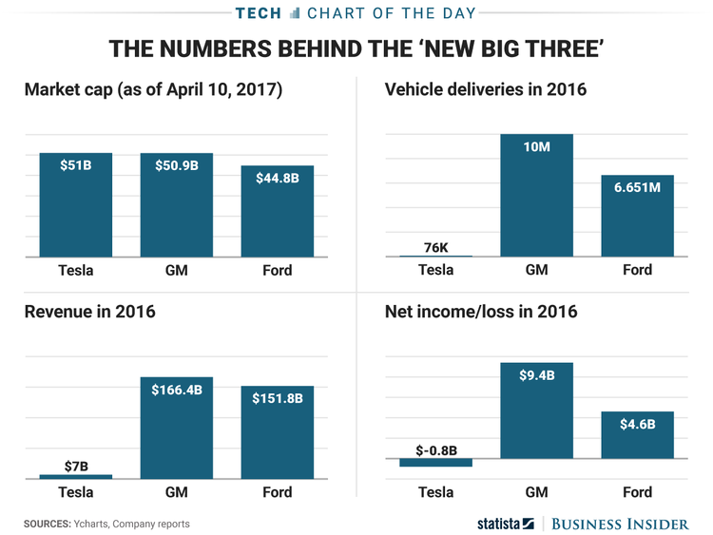
CORPORATE CULTURE
Triple Bottom Line
The Triple Bottom Line is basically how the firm incorporates the 3Ps in the supply chain – People, Planet Profit. GM is moving toward cradle to cradle approach while also putting most of their drive into electric zero emissions vehicles– it is a culture all about Planet. While Ford is also doing this to some extent in comparison to GM Fords efforts are small. In addition, both companies are perusing auto drive technology. Ford’s is cloud based and they have a vision of their auto actually talking to one another, while GMs approach is more autonomous. As far as planet, GM is the leading of the two. On the other hand, Ford is a culture all about people—and profit. Ford is a champion for human rights, diversity in the supply chain – diversity in general – and equality for women. Ford wins in the people category. Revenue is another matter they are both very close for 2018 with about 15 billion dollars difference.
Risk
GM takes more risk than Ford. In the past this obviously did not pay off. GM files for bankruptcy and Ford did not in 2008. GMs bet on electric vehicles is risky also, fighting big oil is not always the wise choice for an automaker. Ford is taking the less risk by promoting people. However, Ford has a history of saying they are for sustainability and then doing nothing.
Notes:
Triple Bottom Line
The Triple Bottom Line is basically how the firm incorporates the 3Ps in the supply chain – People, Planet Profit. GM is moving toward cradle to cradle approach while also putting most of their work into electric zero emissions vehicles– it is a culture all about Planet. While Ford is also doing this to some extent in comparison to GM Fords efforts are small. In addition, both companies are perusing auto drive technology. Ford’s is cloud based and they have a vision of their autos actually talking to one another, while GMs approach is more autonomous. As far as planet, GM is the leading of the two. On the other hand, Ford is a culture all about people—and profit. Ford is a champion for human rights and diversity in the supply chain – diversity in general – and equality for women. Ford wins in the people category. Revenue is another matter they are both very close for 2018 with about 15 billion dollars difference.
Risk
GM takes more risk than Ford. In the past this obviously did not pay off. GM filed for bankruptcy and Ford did not in 2008. GMs bet on electric vehicles is risky also, fighting big oil is not always the wise choice for an automaker. Ford is taking the less risk by promoting people. However, Ford has a history of saying they are for sustainability and then doing nothing.

Slide 14
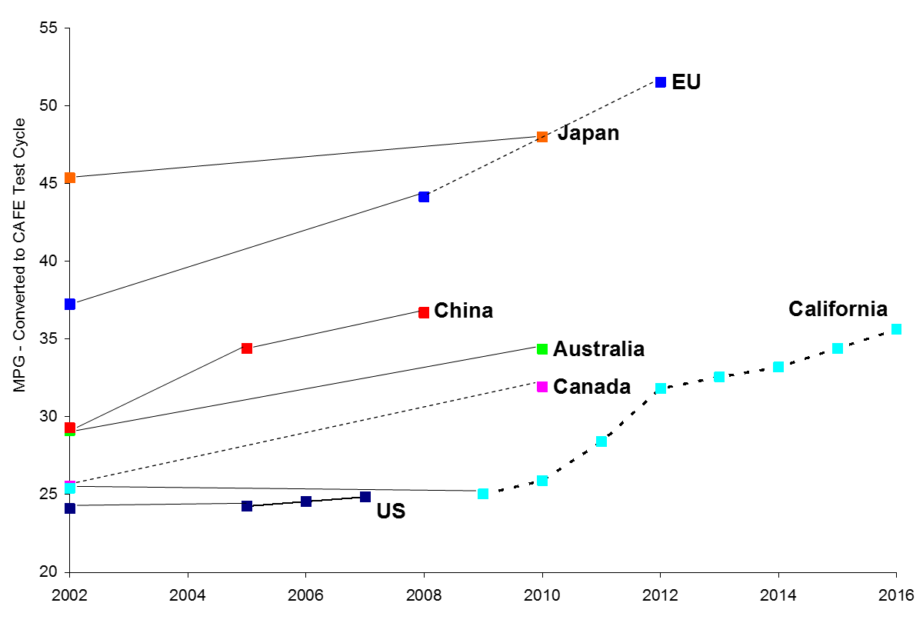
Notes:
Here is where the problem for Ford is. Thanks to the communication age we can see the average mpg around the world. Japan and the EU have already been averaging around 45 mpg since 2010. Notice also that the US is on the bottom averaging only 20 mpg. From a sustainability stand point this is unacceptable. Also now that the people of the US are paying $4 a gallon for gas they are quacking realizing that profits are more important to the US automakers than people. This is one reason today Toyota is at the top of the list for auto sales in the US. The American people have been betrayed by US auto manufacturers.

Slide 15
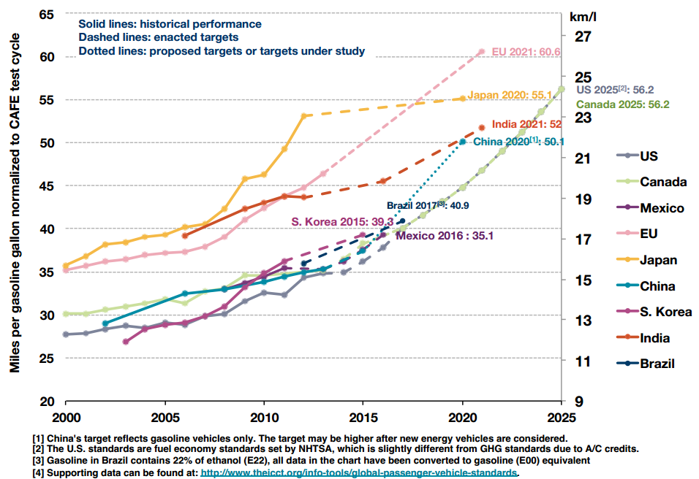
Notes:
Japan is still leading the spot with 50 mpg, but is projected to meet them in 2025. Of coarse shell oil was able to get over 300 mpg in there tests, but we still will not touch that. Ford with it sellout to big oil in focusing on Hybrid technology may end up being the loser here. It depends on how one looks at it, if the people demand the sustainability and environmental conscience that GM feels they will, they will be the clear winner and Ford will lose out, however, if big oil wins out as they have for the past fifty years, GM could be left in bankruptcy and Ford will win out. Other technologies to improve or replace fossil fuel use has also been suppressed. The Pogue Carburetor was side stepped by putting additives into gasoline which were knowingly harmful to people in the name of profit, and gasifier technologies that used to be available in Prat Whitney catalogues where suppressed which allows one to run engines from wood and bio mass (Bio, 1998).

Slide 16
SUPPLIER CODE OF CONDUCT
GM
Senior Vice President of Global Purchasing and Supply Chain (GPSC) oversees the GM Supplier Code of Conduct and making certain that supply chain standards are defined and understood. The GPSC ensures GM’s and GM’s partners have mutual success and deliver higher value. Priorities for the code of conduct include: that suppliers accept GM’s terms and conditions, expect that suppliers certify compliance with laws, expectations for ethical social and business and environmental practice, adhere to requirements which clearly states a ban preventing any use of child labor, forced labor, abusive treatment of employees, data protection and privacy, wages, hours and conditions of employment, subcontractor selection, anti-discrimination, occupational health/safety and motor vehicle safety.
FORD
Ford does not have a Code of Conduct for suppliers but has what is called an Aligned Business Framework (ABF). This strategic purchasing model began in 2005. Ford sought after long-term agreements with strategic suppliers increasing openness, dialogue within a partnership attitude. Moving away of non-compliance rules that could mean the end of Ford’s orders to non-complying suppliers. ABF agreements establish working boundaries for both Ford and the supplier in comprehensive business practices designed to increase future collaboration – of which extended sourcing and data transparency is one. The ABF agreement results in Ford’s supplier partners taking greater responsibility in ensuring proper working conditions and environmental management systems in their value chain. Suppliers are expected to adopt a working conditions code similar to Ford’s and proceed to develop training and compliance systems for their supply chains.
Notes:
One member of GM’s senior leadership is the Senior Vice President of Global Purchasing and Supply Chain (GPSC). This position is considered to be the driver of the company’s strategy. Responsible for making certain that supply chain standards are defined and understood the GPSC works with suppliers to fast-track innovation, eliminate waste and deliver superior financial performance, while reshaping how the company and its suppliers work together. The GPSC ensures GM’s and GM’s partners have mutual success and deliver higher value. Priorities for the code of conduct include: that suppliers accept GM’s terms and conditions, expect that suppliers certify compliance with laws, expectations for ethical social and business and environmental practice, adhere to requirements which clearly states a ban preventing any use of child labor, forced labor, abusive treatment of employees, data protection and privacy, wages, hours and conditions of employment, subcontractor selection, anti-discrimination, occupational health/safety and motor vehicle safety (Sustain, 2018).
Ford does not have a Code of Conduct for suppliers but has what they call the next evolutionary step called an Aligned Business Framework (ABF). This strategic purchasing model began in 2005. Ford sought after long-term agreements with strategic suppliers increasing openness, dialogue within a partnership attitude. Moving away of non-compliance rules that could mean the end of Ford’s orders to non-complying suppliers. ABF agreements establish working boundaries for both Ford and the supplier in comprehensive business practices designed to increase future collaboration – of which extended sourcing and data transparency is one. The ABF agreement results in Ford’s supplier partners taking greater responsibility in ensuring proper working conditions and environmental management systems in their value chain. Suppliers are expected to adopt a working conditions code similar to Ford’s and proceed to develop training and compliance systems for their supply chains (UN, 2014).

Slide 17
COMMUNICATION AND TRAINING
GM
First, the GM Supplier Business Council who have a monthly meetings with GM leadership where dissemination of vision, new procedures, and evaluations can occur. In late 2018 GM combined the Supplier Business Council with the Diversity Council to enhance the collective voice and improve efficiency. GM tries to have the best-trained environmental professionals in the world to lead by example. GM training includes implementation of corrective and preventive actions, effective use of safety data sheets, management of GHGs and regulatory requirements for air, and waste and water. GM feels that communication and training begin with management who are the best trained in all areas such as sustainability along with those who are adept communicators. The idea is professional ethic people train professional ethical people. When Amazon decided to move into autos they hired Alicia Boler Davis from GM
FORD
Ford prefers the one on one model and provides training within their AFB supplier management framework. Further, Ford provides training through the special supplier web portal. The Ford Supplier Portal (FSP) allows Ford to share information and conduct business with its suppliers in a secure web environment. Ford’s work to address human rights and diversity extends throughout the supply chain. Ford feels that training on human rights is essential. Fords approach to training has been developed and launched through the AIAG, which involves e-learning module and face-to-face workshops. These workshops stress the role of human rights, diversity, legal obligations, as well as, industry guidelines and international best practice. Participants must verify training is performed. Ford recently championed the Female Driver Training initiative in Arabia in a push for the global rights for women.
Notes:
The GPSC has several forums for formal supplier engagement. First, the GM Supplier Business Council consists of 19 global who have a monthly meeting with GM leadership where dissemination of vision, new procedures, and evaluations can occur. In late 2018 GM combined the Supplier Business Council with the Diversity Council to enhance the collective voice and improve efficiency. By striving to have the best-trained environmental professionals in the world, GM addresses a variety of issues, including, but not limited to, implementation of corrective and preventive actions, effective use of safety data sheets, management of GHGs and regulatory requirements for air, and waste and water. GM feels that communication and training begin with management who are the best trained in all areas such as sustainability along with those who are adept communicators (Gm.com, 2019).
Ford prefers the one on one model and provides training within their AFB supplier management framework. Further, Ford provides training through the special supplier web portal. The Ford Supplier Portal (FSP) allows Ford to share information and conduct business with its suppliers in a secure web environment (Portal 2019). Additionally, Ford sponsors many internships. Ford’s work to address human rights extends throughout the supply chain. Ford feels that training on human rights is essential. Fords approach to training has been developed and launched through the AIAG, which involves e-learning module and face-to-face workshops. These workshops stress the role of human rights and legal obligations, as well as industry guidelines and international best practice. Participants must verify training is performed (Sustain, 2019).

Slide 18
SIX RISK FACTORS COMPARED
GM
1. Financial Risk. GM manages financial risk in many ways. First, GM is very diversified, though GM’s vision for sustainability is not as most of GM’s focus is on the Electric Vehicle.
2. Environmental Risk; GM employs an Environmental Management System that is continually searching for ways to lower environmental impact. Further, they are committed to renewable energy and zero emissions, goals of taking care of our planet, waste reduction, water conservation and quality, greenhouse gas emissions & climate change, energy management, renewable energy, environmental management system, improving technologies, environmental stewardship, responsible sourcing, and obeying environmental regulations and policies (Operations, 2019).
Ford
1. Financial Risk. First, Ford is very diversified. This is the most prominent feature for managing financial risk for Ford. However, Ford has electric vehicles in production, Ford’s focus is Diversity, and Hybrid Technologies.
2. Environmental Risk; Ford’s Issue-Specific Strategies include a Climate Change Strategy, Sustainable Materials Strategy, Renewable Energy Strategy, Human Rights Strategy, and Circular Economy Strategy. Further, Ford touts the following items listed form the Sustainability Report are access, climate change- zero air emissions from our facilities not vehicles, energy-- use 100 percent renewable energy by 2035, waste-- zero waste to landfill with no single-use plastics from our operations by 2030. water-- aspiring to use freshwater for human consumption only, materials-- to use recycled and renewable only, human rights, and diversity (Sustain, 2018).
Notes:
GM
1. Financial Risk. GM manages financial risk in many ways. First, GM is very diversified, though GM’s vision for sustainability is not as most of GM’s focus is on the Electric Vehicle.
2. Environmental Risk; GM employs an Environmental Management System that is continually searching for ways to lower environmental impact. Further, they are committed to renewable energy and zero emissions, goals of taking care of our planet, waste reduction, water conservation and quality, greenhouse gas emissions & climate change, energy management, renewable energy, environmental management system, improving technologies, environmental stewardship, responsible sourcing, and obeying environmental regulations and policies (Operations, 2019).
Ford
1. Financial Risk. First, Ford is very diversified. This is the most prominent feature for managing financial risk for Ford. However, Ford has electric vehicles in production, Ford’s focus is Diversity, and Hybrid Technologies.
2. Environmental Risk; Ford’s Issue-Specific Strategies include a Climate Change Strategy, Sustainable Materials Strategy, Renewable Energy Strategy, Human Rights Strategy, and Circular Economy Strategy. Further, Ford touts the following items listed form the Sustainability Report are access, climate change- zero air emissions from our facilities not vehicles, energy-- use 100 percent renewable energy by 2035, waste-- zero waste to landfill with no single-use plastics from our operations by 2030. water-- aspiring to use freshwater for human consumption only, materials-- to use recycled and renewable only, human rights, and diversity (Sustain, 2018).

Slide 19
SIX RISK FACTORS COMPARED
GM
3. Brand/Reputation Risk; GM is the fourth largest automotive provider in the world (Jones, 2019) with not many other brands under them; some may feel that it would be impossible to smear the name “Jimmy.” One has only to look at such epic fails as the “Vega” or the “Luv Truck” to know that customers are fickle. Today most people drive out of necessity, and most have heard never ending rumors of the 300 mpg cars since the 1960s. Today as GM is at the forefront of the electric car, a sense of appreciation comes over those of us that understand that our bondage to big oil may soon be over.
GM looks at long-term solution by addressing the use of fossil fuels.
Ford
3. Brand/Reputation Risk; Ford is the sixth largest automotive provider in the world (Jones, 2019) with not many other brands under them. Built Ford tough is well known. Though the Mustang II was their worst car ever, however, the pinto outperformed the Chevy Vega which saved face for Ford. Ford is the go to truck of choice for the farming community; as such, it is likely Ford will remain a world favorite.
Ford looks at long-term solutions by addressing diversity and human rights.
Notes:
GM
3. Brand/Reputation Risk; GM is the fourth largest automotive provider in the world (Jones, 2019) with not many other brands under them; some may feel that it would be impossible to smear the name “Jimmy.” One has only to look at such epic fails as the “Vega” or the “Luv Truck” to know that customers are fickle. Today most people drive out of necessity, and most have heard never ending rumors of the 300 mpg cars since the 1960s. Today as GM is at the forefront of the electric car, a sense of appreciation comes over those of us that understand that our bondage to big oil may soon be over.
GM looks at long-term solution by addressing the use of fossil fuels.
Ford
3. Brand/Reputation Risk; Ford is the sixth largest automotive provider in the world (Jones, 2019) with not many other brands under them. Built Ford tough is well known. Though the Mustang II was their worst car ever, however, the pinto outperformed the Chevy Vega which saved face for Ford. Ford is the go to truck of choice for the farming community; as such, it is likely Ford will remain a world favorite.
Ford looks at long-term solutions by addressing diversity and human rights.

Slide 20
CUSTOMER-DRIVEN REQUIREMENTS
In attempting to articulate the primary strategic differences between Ford and GM’s customer-driven strategies one might feel that the Ford strategies serve the customer better when not considering global warming and fossil fuel use. The truth is that Ford is seeking to keep the world bound to fossil fuels, and even betray Americans is delivering same model vehicles to US residence that use more fuel than the same models they sell on other continents. When on looks at the human rights and diversity efforts of Ford one get a sense that these efforts are non less than a smoke screen hiding the truth of minimal efforts for true sustainability.
GM, on the other hand, is not clouding the vision, as they go whole heartedly into electric vehicle, planning to have 90% of what they sell electric by 2030. In the long run this better serves people. Human rights and diversity are useless in the earth does not support life properly. Further, the move from fossil fuels brightens the future of humanity, one where people are not slaves to economics.
In socially responsible best practices in terms of the whole supply chain currently the two break even. Ford with its water, renewable energy, zero one use plastics, and using only recycled plastics for production is about even with GM’s zero landfill, owned landfills, renewable energy, and zero emission vehicle goals.
Notes:
In attempting to articulate the primary strategic differences between Ford and GM’s customer-driven strategies one might feel that the Ford strategies serve the customer better when not considering global warming and fossil fuel use. The truth is that Ford is seeking to keep the world bound to fossil fuels. Already US automakers betray Americans by delivering same model vehicles to US residence that use more fuel than the same models they sell on other continents. When on looks at the human rights and diversity efforts of Ford one get a sense that these efforts are non less than a smoke screen hiding the truth of minimal efforts for true sustainability.
GM, on the other hand, is not clouding the vision, as they go whole heartedly into electric vehicle, planning to have 90% of what they sell electric by 2030. In the long run this better serves people. Human rights and diversity are useless in the earth does not support life properly. Further, the move from fossil fuels brightens the future of humanity, one where people are not slaves to economics.
In socially responsible best practices in terms of the whole supply chain currently the two break even. Ford with its water, renewable energy, zero one use plastics, and using only recycled plastics for production is about even with GM’s zero landfill, owned landfills, renewable energy, and zero emission vehicle goals.

Slide 21
HAZARDOUS/REGULATED MATERIALS AND DOCUMENTATION
Ford approach to hazmat is to have extensive use of safety data sheets which log the management of GHGs and regulatory requirements for air, waste, and water is just one way that Ford tracks and documents all regulated materials (Data Sheets, 2019). This tracking of regulated materials from cradle to grave allows Ford to regulate hazmat waste concerning conflict materials such things as hex chrome, lead, mercury, and copper from its source to end of life.
As of December 31, 2017, 80 (or approximately 50%) of GM’s industrial operations were landfill-free, in addition to the 63 of non-manufacturing operations. GM the composting program --a most successful example of the circular economy. These efforts are minimizing environmental impact, generating revenue from the sales from by-products, limiting raw material through the use of recycling, cutting the carbon footprint and lowering financial liabilities associated with waste disposal (AR, 2017). Further, other major companies, along with GM, have all generated sustainability reports to track progress. Further, they have been ranked by a number of indices, such as the Dow Jones Sustainability Index and the Newsweek Green Score (Buss, Croteau, Davidson, Kerrey, &Van De Winkle, 2014), in addition to the use of safety data sheets which log the management of GHGs and regulatory requirements for air, waste, and water that Ford uses (Reporting, 2019).
Notes:
Ford approach to hazmat is to have extensive use of safety data sheets which log the management of GHGs and regulatory requirements for air, waste, and water is just one way that Ford tracks and documents all regulated materials (Data Sheets, 2019). This tracking of regulated materials from cradle to grave allows Ford to regulate hazmat waste concerning conflict materials such things as hex chrome, lead, mercury, and copper from its source to end of life.
As of December 31, 2017, 80 (or approximately 50%) of GM’s industrial operations were landfill-free, in addition to the 63 of non-manufacturing operations. GM the composting program --a most successful example of the circular economy. These efforts are minimizing environmental impact, generating revenue from the sales from by-products, limiting raw material through the use of recycling, cutting the carbon footprint and lowering financial liabilities associated with waste disposal (AR, 2017). Further, other major companies, along with GM, have all generated sustainability reports to track progress. Further, they have been ranked by a number of indices, such as the Dow Jones Sustainability Index and the Newsweek Green Score (Buss, Croteau, Davidson, Kerrey, &Van De Winkle, 2014), in addition to the use of safety data sheets which log the management of GHGs and regulatory requirements for air, waste, and water that Ford uses (Reporting, 2019).

Slide 22
CRADLE TO GRAVE AND BEYOND
GM is forging forward in the cradle to cradle with reverse supply chain management in mind. First, efforts to use recycling by hosting their own GM auto recycling centers (Recycling, 2019) to reclaim metals, plastics, glass, and other useful items. Metals are melted and recast, plastics are recycled to pellets or turned back into oils through heat exchangers, and tires are ground for use in highways. In addition, landfills are being phased out with the goal of a full cradle to cradle process (Sustain, 2018). Indeed, GM’s approach to waste management in viewing waste as a resource out of place has shown promise (Buss et al., 2014).
This approach minimizes risk while making revenue from what other firms consider waste. Further, in the long run this may put GM in front of other automakers by building to the future instead of for the dollar.
Notes:
GM is forging forward in the cradle to cradle with reverse supply chain management in mind. First, efforts to use recycling by hosting their own GM auto recycling centers (Recycling, 2019) to reclaim metals, plastics, glass, and other useful items. Metals are melted and recast, plastics are recycled to pellets or turned back into oils through heat exchangers, and tires are ground for use in highways. In addition, landfills are being phased out with the goal of a full cradle to cradle process (Sustain, 2018). Indeed, GM’s approach to waste management in viewing waste as a resource out of place has shown promise (Buss et al., 2014).
This approach minimizes risk while making revenue from what other firms consider waste. Further, in the long run this may put GM in front of other automakers by building to the future instead of for the dollar.

Slide 23
CRADLE TO GRAVE AND BEYOND
Ford tinkers with Cradle to Cradle and Reverse Supply Chain Management. First, William McDonough, signed a contract in 1999 with the automaker to re-design the River Rouge complex in Michigan with a living green roof. This was met by some reluctance at first until the EPA developing new stormwater regulations which would have cost Ford $50 million. McDonough’s natural stormwater management system cost only $15 million. As a result, Ford installed its first living green roof.
More recently, Ford was noticed once more when it unveiled its “Model U” concept car a vehicle powered by a hydrogen engine and including Milliken & Co. upholstery fabric, chosen for their environmental health assets, and capable of perpetual recycling (MacArthur, 2010).
Ford is way behind GM when it comes to zero landfill with its ZWTL goal, something GM achieved in 2017.
Notes:
Ford tinkers with Cradle to Cradle and Reverse Supply Chain Management. First, William McDonough, signed a contract in 1999 with the automaker to re-design the River Rouge complex in Michigan with a living green roof. This was met by some reluctance at first until the EPA developing new stormwater regulations which would have cost Ford $50 million. McDonough’s natural stormwater management system cost only $15 million. As a result, Ford installed its first living green roof.
More recently, Ford was noticed once more when it unveiled its “Model U” concept car a vehicle powered by a hydrogen engine and including Milliken & Co. upholstery fabric, chosen for their environmental health assets, and capable of perpetual recycling (MacArthur, 2010).
Ford is way behind GM when it comes to zero landfill with its ZWTL goal, something GM achieved in 2017.

Slide 24
CONCLUSION
CONCLUSION
This presentation covers just a few of the details concerning Ford and GM SCS.
To recap supply chain sustainability means green purchasing, mfg., distribution, reverse supply chains and logistics, integrating the three Ps (people, planet and profit), considering the entire life cycle of a product--including all point of views.
SCS means to do no harm to the environmental or social systems, while still making profit in the long run and finally the effective use of sustainable market frameworks such as Cradle to Cradle, Reverse Supply Chain & Closed Loop or Green Innovative options that work in harmony.
GM and Ford are working toward green manufacturing, and low emission logistics. When looking at the three P’s Ford is more about people and GM is more about planet. With hazardous waste Ford comes out in front with their source tracking of conflict materials, both get a current grade of “D” when is comes to environmental systems like water reclamation, but for social Ford wins out as it put emphasis on diversity and human rights. GM is far above Ford in Cradle to Cradle with its own dismantlers and reclamation centers, while Ford attempt with their “Go Green” initiative fail to compete. However, Ford does forge new territory with its 100% goal of using recycled plastics in the productions of its cars.
Notes:
CONCLUSION
This presentation covers just a few of the details concerning Ford and GM SCS.
To recap supply chain sustainability means green purchasing, mfg., distribution, reverse supply chains and logistics, integrating the three Ps (people, planet and profit), considering the entire life cycle of a product--including all point of views.
SCS means to do no harm to the environmental or social systems, while still making profit in the long run and finally the effective use of sustainable market frameworks such as Cradle to Cradle, Reverse Supply Chain & Closed Loop or Green Innovative options that work in harmony.
GM and Ford are working toward green manufacturing, and low emission logistics. When looking at the three P’s Ford is more about people and GM is more about planet. With hazardous waste Ford comes out in front with their source tracking of conflict materials, both get a current grade of “D” when is comes to environmental systems like water reclamation, but for social Ford wins out as it put emphasis on diversity and human rights. GM is far above Ford in Cradle to Cradle with its own dismantlers and reclamation centers, while Ford attempt with their “Go Green” initiative fail to compete. However, Ford does forge new territory with its 100% goal of using recycled plastics in the productions of its cars.

Slide 25
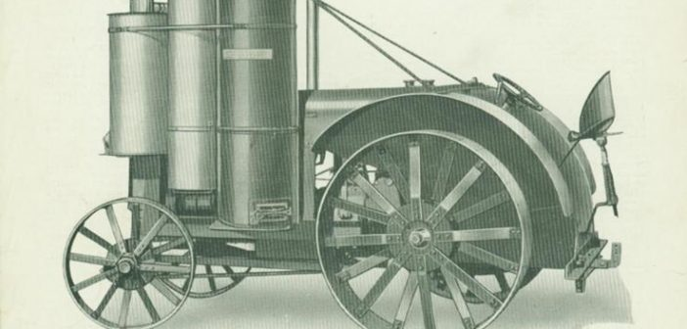
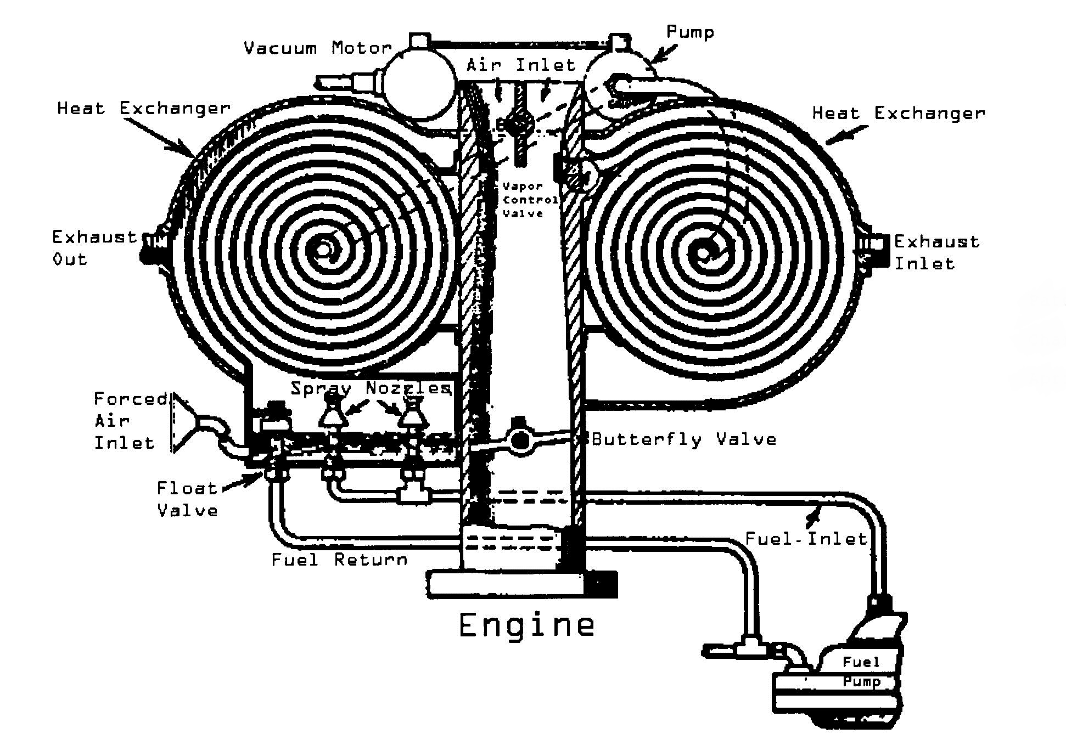
CONCLUSION
CONCLUSION
Which organization manages its supply chain in a more sustainable and socially responsible way?
Both are not doing well. For some of the largest firms in the world it is amazing that value to the stakeholders is not of more importance. Historically both companies of betrayed its stakeholders by reducing so greatly the mpg of its vehicles. To compound this is the compliance to put additive such as lead into white gas to preclude such advancements as the Pogue Carburetor (Pat, 1934), actively suppressing technologies like the gasifier (Bio, 1998), and the use of petition to side step water reclamation regulations. However, GM is on track to correct these while Ford is not.
Notes:
CONCLUSION
Which organization manages its supply chain in a more sustainable and socially responsible way?
Both are not doing well. For some of the largest firms in the world it is amazing that value to the stakeholders is not of more importance. Historically both companies of betrayed its stakeholders by reducing so greatly the mpg of its vehicles. To compound this is the compliance to put additive such as lead into white gas to preclude such advancements as the Pogue Carburetor (Pat, 1934), actively suppressing technologies like the gasifier (Bio, 1998), and the use of petition to side step water reclamation regulations. However, GM is on track to correct these while Ford is not.
1934-11-03
Application filed by Pogue Charles Nelson
https://patents.google.com/patent/US1997497A/en
https://www.osti.gov/biblio/3726
Milne, T. A., Evans, R. J., & Abatzaglou, N. (1998) Biomass Gasifier ''Tars'': Their Nature, Formation, and Conversion. United States. doi:10.2172/3726.

Slide 26
CONCLUSION
CONCLUSION
Which organization engages risk in a more proactive, sustainable, and socially responsible manner?
GM is taking the riskier road. Ford is playing it safe and is business as usual. GM is moving away from Fossil fuels, being the first major automaker to have a goals of 90% electric vehicles. Tesla and other fully electric firms with the welfare of mankind are excluded in the term “major automaker” as only the top few are taken into consideration. Further, as goals progress it is foreseen that GM will adopt such things as “100% recycled plastics” in productions, as Ford has. Lastly, though Fords focus is on diversity and human rights, GM has these items also but in not using their efforts to shadow the truth.
Thank you for viewing this presentations.
Notes:
CONCLUSION
Which organization engages risk in a more proactive, sustainable, and socially responsible manner?
GM is taking the riskier road. Ford is playing it safe and is business as usual. GM is moving away from Fossil fuels, being the first major automaker to have a goals of 90% electric vehicles. Tesla and other fully electric firms with the welfare of mankind are excluded in the term “major automaker” as only the top few are taken into consideration. Further, as goals progress it is foreseen that GM will adopt such things as “100% recycled plastics” in productions, as Ford has. Lastly, though Fords focus is on diversity and human rights, GM has these items also but in not using their efforts to shadow the truth.
Thank you for viewing this presentations.
1934-11-03
Application filed by Pogue Charles Nelson
https://patents.google.com/patent/US1997497A/en
https://www.osti.gov/biblio/3726
Milne, T. A., Evans, R. J., & Abatzaglou, N. (1998) Biomass Gasifier ''Tars'': Their Nature, Formation, and Conversion. United States. doi:10.2172/3726.

Slide 27
References
Allen, A. (2017) Ford grows sustainable supply chain initiative, Supply Management, Retrieved from: https://www.cips.org/supply-management/news/2017/april/ford-expands-sustainable-supply-chain-initiative/
Amadeo, K. (2019) Auto Industry Bailout. Was the Big 3 Bailout Worth It?, The Balance. Retrieved from: https://www.thebalance.com/auto-industry-bailout-gm-ford-chrysler-3305670
Annual Report(AR) (2017) Annual Reports, investor.com, Retrieved from: https://investor.gm.com/node/18306/html
Annual Report(AR) (2018) Annual Reports, ford.com, Retrieved from: https://s22.q4cdn.com/857684434/files/doc_financials/2018/annual/2018-Annual-Report.pdf
Annual Reports (2019) Annual Reports, annualreports.com, Retrieved from: http://www.annualreports.com/Company/general-motors

Slide 28
Buss, R., Croteau, H., Davidson, S., Kerrey, C., Van De Winkle. (2014) The Sustainability Business Case for General Motors, Master’s Project for the University of Michigan, Retrieved from: https://deepblue.lib.umich.edu/bitstream/handle/2027.42/106571/GM%20Masters%20Project%20Report%20Final%202014.pdf?sequence=1
CBE (2019) Social Responsibility and Risk Final Assessment: Outline and Rubric, Brandman, Retrieved from: https://brandman-cbeupload.s3.amazonaws.com/assets/16265/Social_Responsibility_and_Risk_Final_Assessment.pdf
Comparably (2017) Ford Motor Company Culture - October 2017, video, Retrieved from: https://www.youtube.com/watch?v=iwxVAl50Y7U
Culture (2019) Our Culture, Ford Corporate, Retrieved from https://corporate.ford.com/careers/culture.html

Slide 29
Data Sheets (2019) Material Safety Data Sheet, Ford Motor Company, Retrieved from: https://performanceparts.ford.com/download/PDFS/MSDS%20M-19546-A12%20US%20ENGLISH%202-24-2011.pdf
Davenport, C. (2015) Nations Approve Landmark Climate Accord in Paris, the Associated Press, December 12, 2015. Retrieved from: http://www.ssgates.com/climate-change-textcoding.pdf
EPA (2019) Hazardous Waste Cleanup: Buick City Facility - Flint, Michigan, epa.gov https://www.epa.gov/hwcorrectiveactionsites/hazardous-waste-cleanup-buick-city-facility-flint-michigan
EPA-Sustainability (2019) Sustainability, epa.gov; retrieved from: https://www.epa.gov/sustainability
Ford.com (2019) WebPage Url https://corporate.ford.com
Fortune (2019) Fortune 500 top 100, fortune .com, Retrieved from: http://fortune.com/fortune500/general-motors/
Frank, R (2014) General Motors and the Breakdown of Corporate Social Responsibility, Highbrow Magazine; Retrieved from: https://www.highbrowmagazine.com/4185-general-motors-and-breakdown-corporate-social-responsibility
Gm.com (2019) WebPage Url https://www.gm.com/

Slide 30
Gm Sustainability Report (SR) (2018) Sustainability Report, gm.com, Retrieved from: https://www.gmsustainability.com/_pdf/downloads/GM_2017_SR.pdf
Investor (2018) Investors, gm.com, Retrieved from: https://investor.gm.com/investor-relations
Investors (2018) Investors, ford.com, Retrieved from: https://www.shareholder.ford.com/home/default.aspx
Jones, J. (2019) 10 Largest Automakers in the World, Largest.org, Retrieved from: https://largest.org/technology/automakers/
Karuku, S. (2016) Ford Supply Chain Management, video, Retrieved from: https://www.youtube.com/watch?v=OaDhAnxEDdU
Levin, D (2019) General Motors, In Race to Auto 2.0, Leads In Snagging Israeli High-Tech Partnerships And Talent, Forbe.com Jun 13, 2019, https://www.forbes.com/sites/doronlevin/2019/06/13/general-motors-in-race-to-auto-2-0-leads-in-snagging-israeli-high-tech-partnerships-and-talent/#74146fe35bf5
MacArthur, E (2010) Ford Motor Company River Rouge production plant (Michigan, USA), the Ellen MacArthur Foundation, Retrieved from: https://www.ellenmacarthurfoundation.org/news/ford-motor-company-river-rouge-production-plant-michigan-usa

Slide 31
National, A. (2019) Hazardous Waste Management System; Identification and Listing of Hazardous Waste Final Exclusion, federalregistar.gov, https://www.federalregister.gov/documents/2003/07/30/03-19285/hazardous-waste-management-system-identification-and-listing-of-hazardous-waste-final-exclusion
Operations (2019) Operations, gm.com, Retrieved from: https://www.gmsustainability.com/manage/operations.html
Portal (2019) Ford Supplier Portal, Url https://fsp.portal.covisint.com/web/portal/
Recycling (2019) GM Auto Recycling, Inc. JunkYard, Retrieved from: https://www.salvageparts.com/junk-yards/gm-auto-recycling-inc-rancho-cordova
Reporting (2019) Reporting Practices, gm.com, Retrieved from: https://www.gmsustainability.com/aspire/reporting.html
Shell Oil (1977). Fuel Economy of the Gasoline Engine, John Wiley & Sons, New York. (ISBN 0-470-99132-1)
Somerville, H (2018) GM's driverless car bet faces a long road ahead, reuters.com, Retrieved from: https://www.reuters.com/article/us-gm-selfdriving-cruise-insight/gms-driverless-car-bet-faces-long-road-ahead-idUSKCN1MY0CK

Slide 32
SustainGM (2018) Our management approach to Supply Chain, gm.com, Retrieved from: ` https://www.gmsustainability.com/manage/supply.html
Sustain (2018) Sustainability Report, ford.com, Retrieved from: https://corporate.ford.com/microsites/sustainability-report-2018-19/assets/files/sr18.pdf
UN (2014) Ford Motor Company: The Aligned Business Framework, United Nations Global Compact Sustainable Supply chains: Resources & Practices: Retrieved from http://supply-chain.unglobalcompact.org/site/article/50
Whalan, M. (2006) Ford Manufacturing Supply Chain, video, https://www.youtube.com/watch?time_continue=23&v=qyO9QSo0FjU

