Slide 2
What is Happening at PcC

Slide 4
What is Happening at PcC

Slide 5
7 pm in the Main Sanctuary

Slide 7
What is Happening at PcC

Slide 8
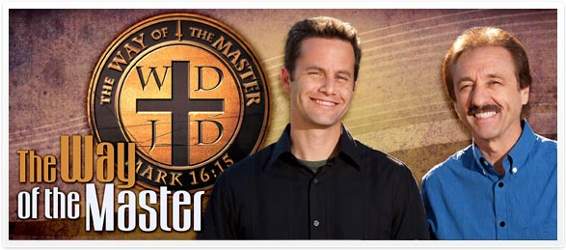
Alternate Fridays Global Youth Evangelism The Way of the Master
Fridays at 7pm

Slide 9
Events Calendar
Pastors and Evangelists
Lee and April Limparis
Jan 21rst and 22nd @ Praise Chapel Yuba City

